Slide 1
Stock Price Prediction Analysis
Group 6
SaiBhargav Podili
Pavan Srivatsav Devarakonda
Sanjana Chippada
Madhura Deshmukh

Slide 2
INTRODUCTION
Financial markets are volatile, unpredictable, and generate massive data streams.​
Traditional stock price prediction methods rely on assumptions and oversimplified models.
Fundamental Analysis: Uses company performance metrics.​
These approaches fail to capture complex relationships and evolving trends.​
Machine Learning (ML), especially LSTM Networks, offers the ability to process large datasets and detect non-linear patterns in time-series data.

Slide 3

OBJECTIVE
To design an integrated system that combines:​
Predict the stock price using advanced machine learning models to capture the complexity of stock price movements.
Real-time data acquisition and analysis.​
User-friendly visualizations to make insights accessible and actionable for investors and analysts.

Slide 4
RESEARCH PROBLEM​
Challenges in Stock Price Prediction:​
Non-Stationarity: Stock prices are influenced by numerous unpredictable external factors, including economic, political, and company-specific events.​
High Dimensionality: Financial datasets often include multiple variables and features that interact in complex ways.​
Real-Time Decision-Making: Investors and analysts require systems that provide timely insights to capitalize on market opportunities.​
Lack of Integration: Existing systems may lack seamless integration of predictive models with real-time data streams and user-friendly visualization platforms.​

Slide 5
RESEARCH PROBLEM​
Significance of Addressing This Problem:​
Enhancing the accuracy of predictions can improve investment decisions.​
Real-time insights can help analysts react quickly to market changes.​
Bridging the gap between machine learning research and practical financial applications offers a competitive edge.

Slide 6
TECHNOLOGIES USED
LSTM Networks: Predict future stock prices using historical data.​
Apache Kafka: Real-time stock data streaming.​
InfluxDB: High-frequency data storage.​
Grafana: Visualization of real-time and predicted stock prices.

Slide 7

SYSTEM ARCHITECTURE​
Data Acquisition:​
Historical data: Yahoo Finance (yfinance library).​
Real-time data: Apache Kafka streams live data every minute.​
Data Storage:​
Historical and real-time data stored in InfluxDB.​
Model Training:​
LSTM network learns long-term dependencies in stock data.​
Prediction and Streaming:​
Kafka integrates predictions with live data streams.​
Visualization:​
Grafana dashboard displays stock trends and predictions.​

Slide 8
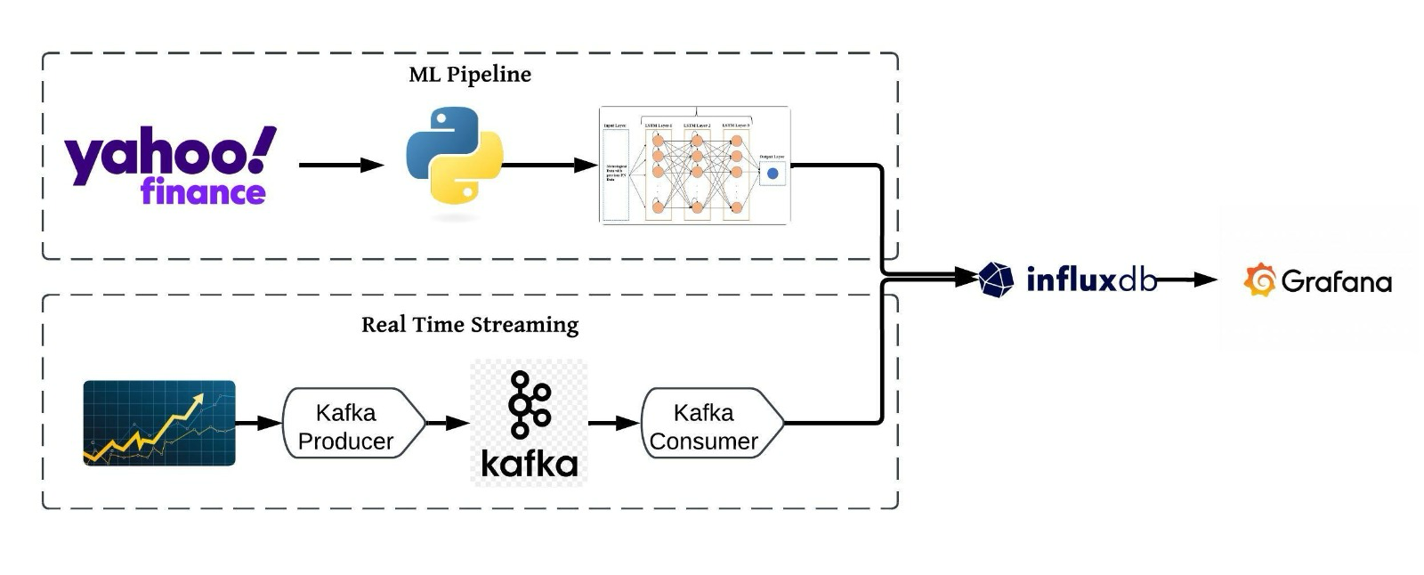
METHODOLOGY FLOWCHART

Slide 9
DATASET
Primary Data Source​- Yahoo Finance:​
Reliable and rich source of historical stock market data.​
Seamless integration using Python’s yfinance library for bulk data retrieval.​
Attributes Extracted​:
Pricing Information:​
Open Price: Starting value of a stock on a trading day.​
Close Price: Final value at the end of the trading day.​
High Price: Peak value during the day.​
Low Price: Lowest value during the day.​
Volume:
Total number of shares traded.​
Indicates market activity and investor sentiment.​
Adjusted Close:
Reflects true stock value after accounting for corporate actions (e.g., dividends, splits).​
Crucial for long-term trend analysis.​
​
Item 2

Slide 10
LSTM MODEL FOR STOCK PRICE PREDICTION​
Why LSTM?​
Designed for time-series data like stock prices.​
Captures long-term dependencies critical for identifying:​
Trends over days, weeks, or months.​
Seasonal variations and market cycles.​
Helps investors by anticipating future stock prices based on historical data.​
Key Features of LSTMs:​
Learn and remember from extended intervals of data.​
Ideal for capturing both short-term and long-term stock price patterns.​
Item 2

Slide 11
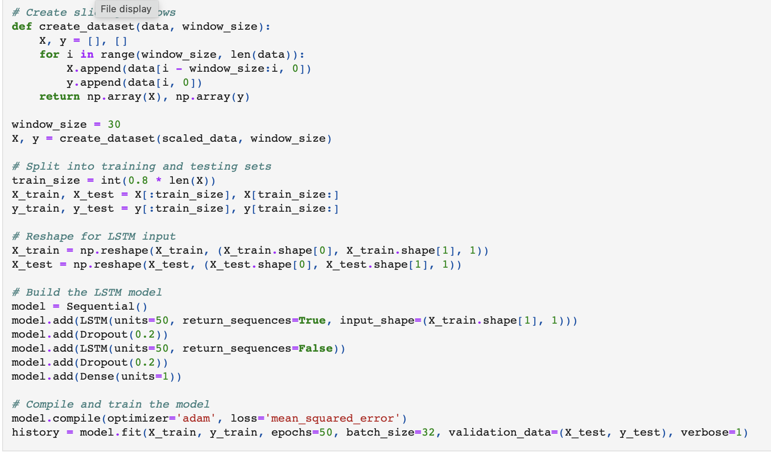
HYPERPARAMETER TUNING

Slide 12
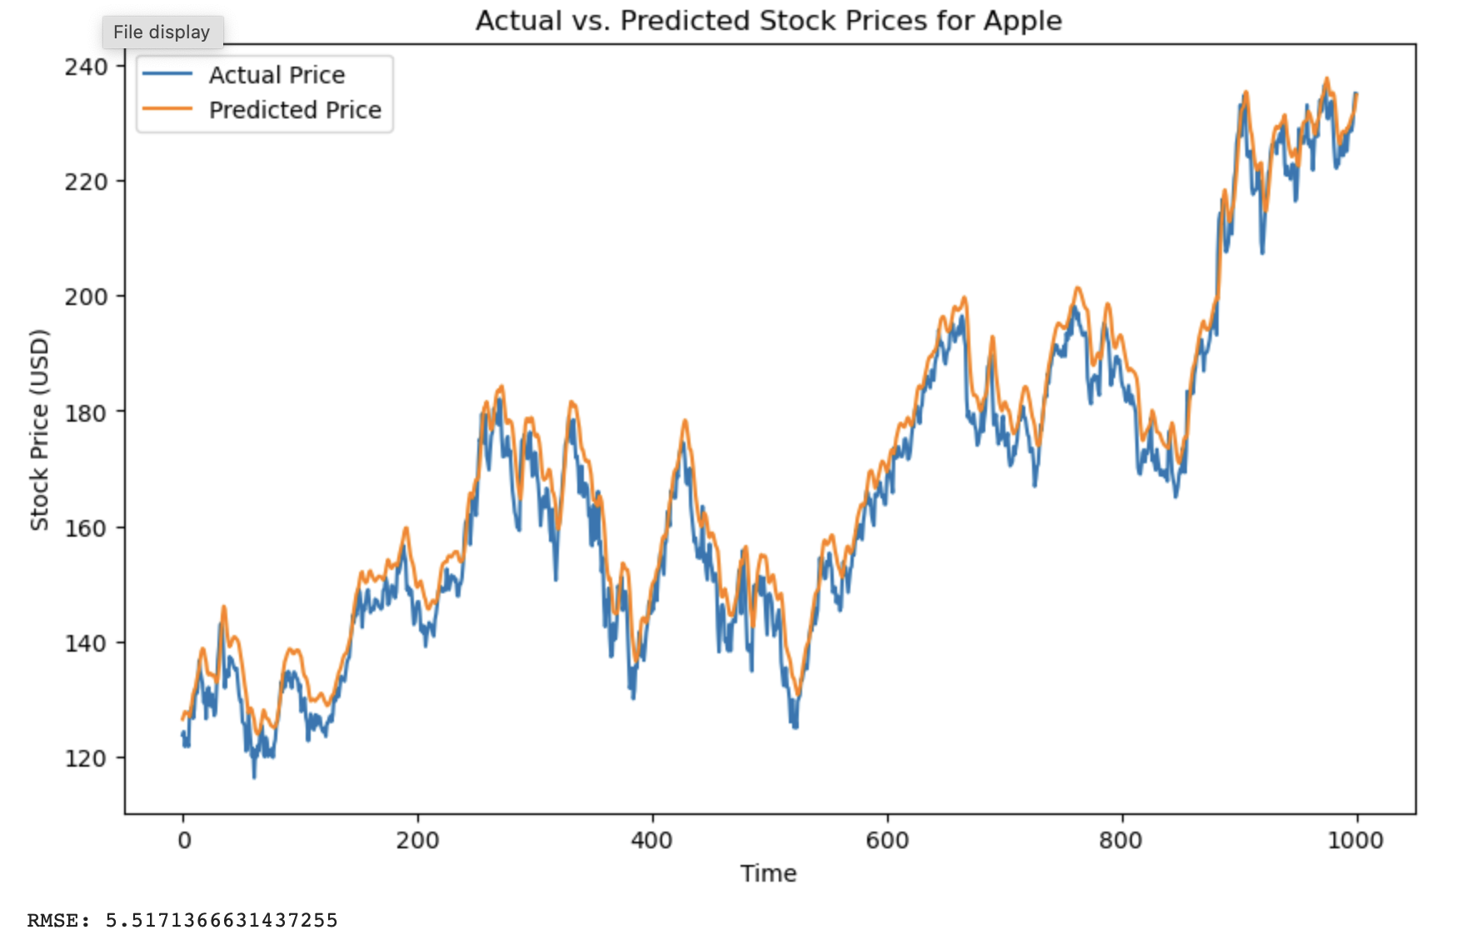
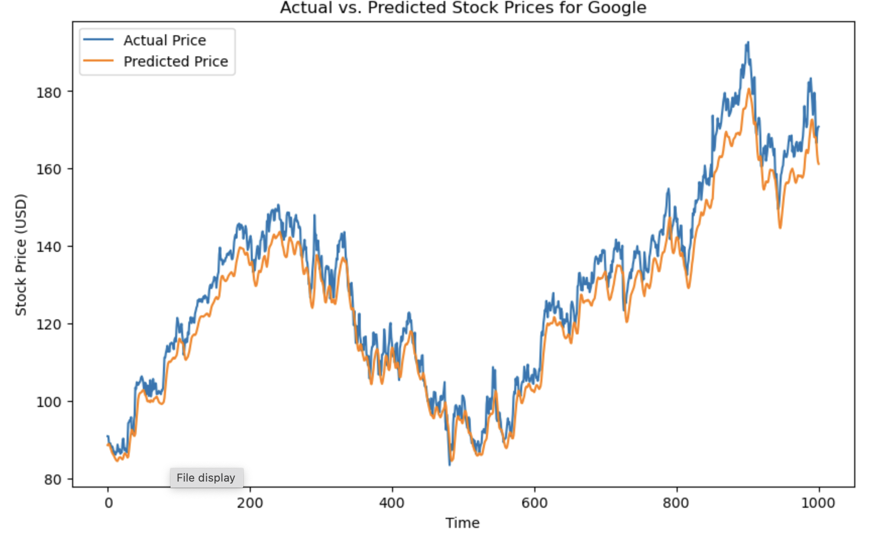
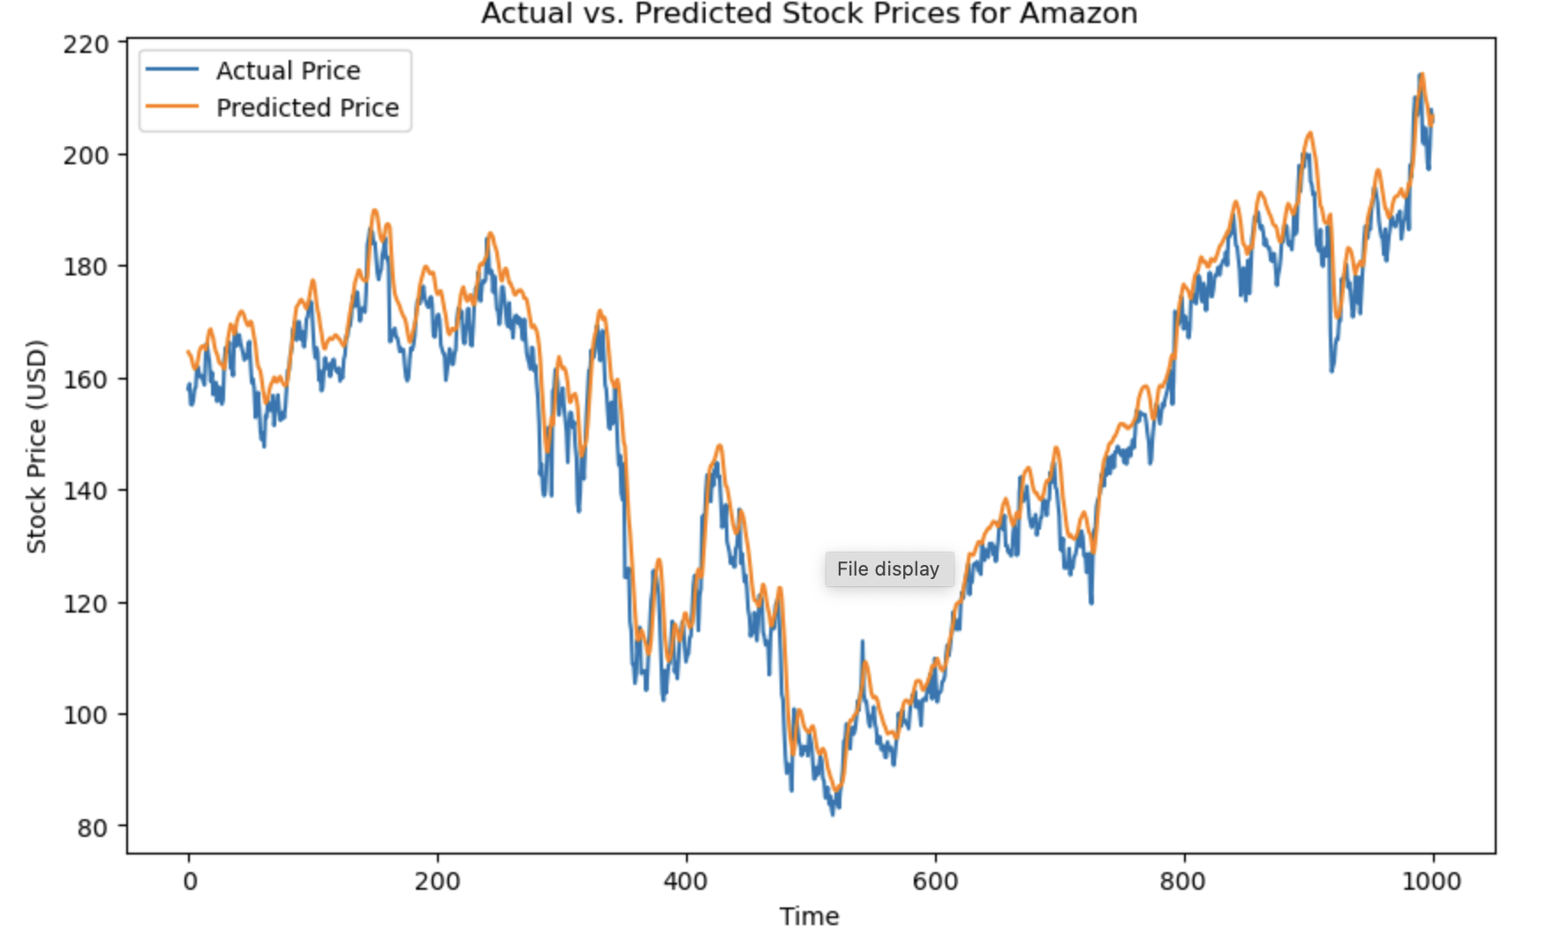
ACTUAL VS. PREDICTED STOCK PRICES FOR DIFFERENT COMPANIES
Item 2

Slide 13
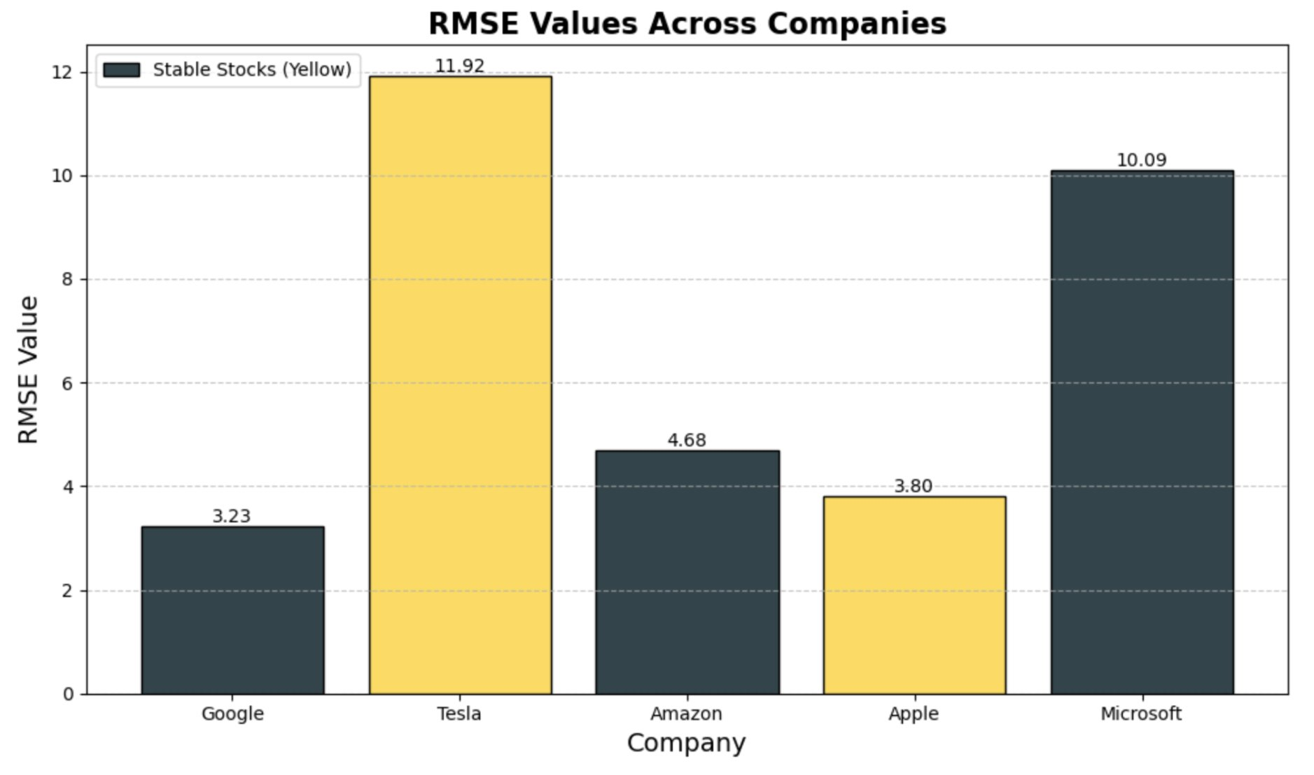
MODEL EVALUATION
Evaluation Metric:​ Root Mean Squared Error (RMSE): Measures prediction accuracy by calculating average error between actual and predicted values.​
​
​
Item 2

Slide 14
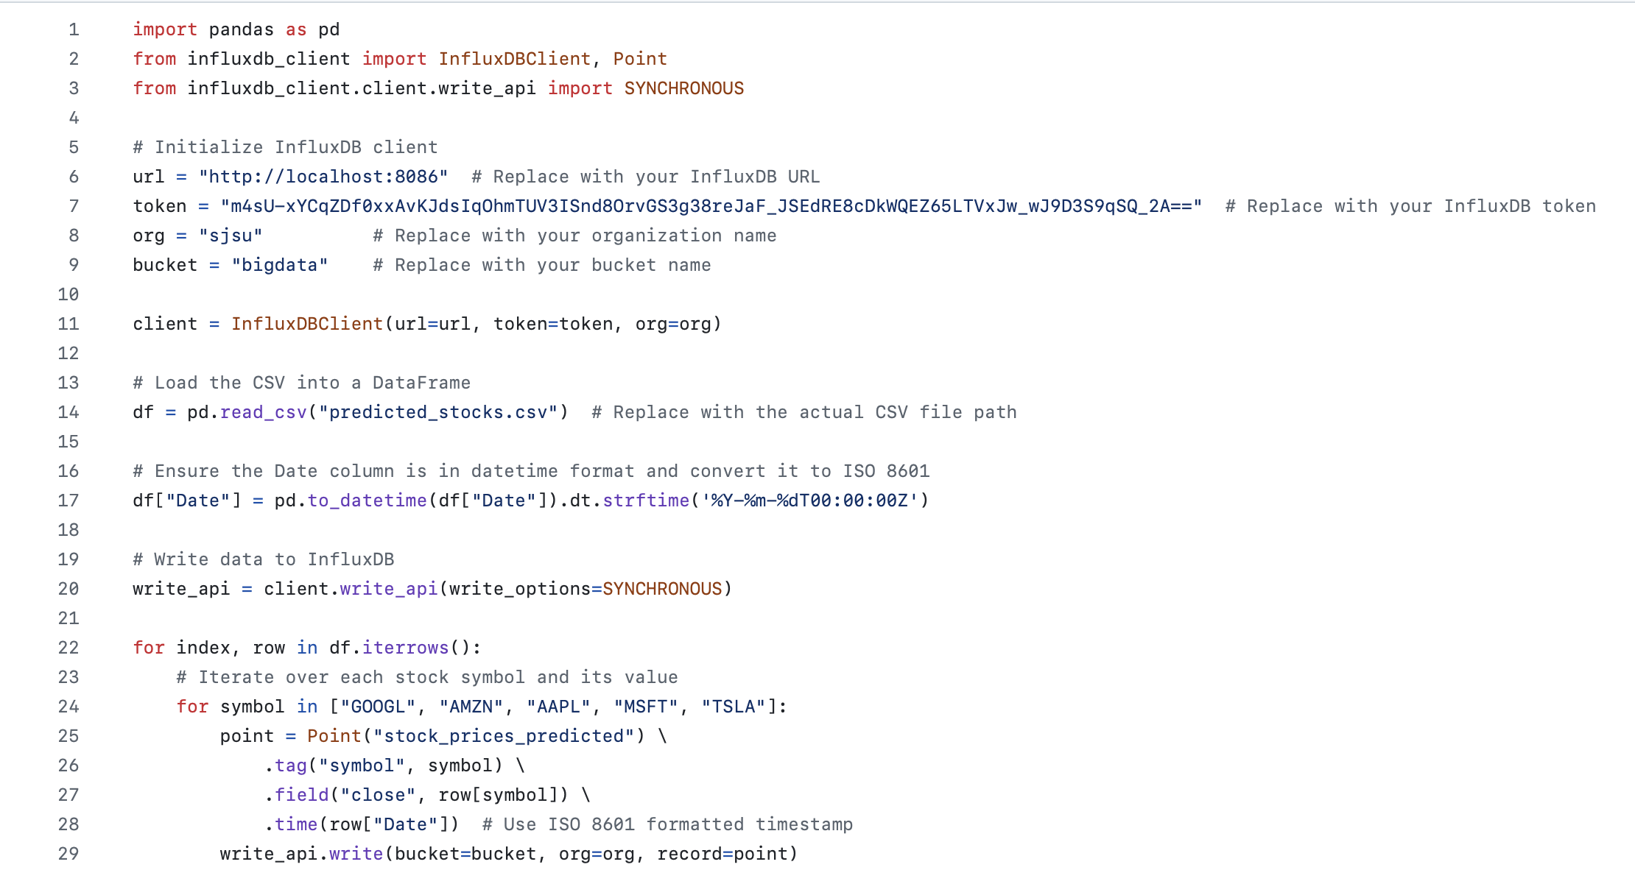
Pushing predicted stock prices to InfluxDB

Slide 15
Real-Time Data Streaming with Apache Kafka​
Kafka Architecture:​
Producer:​
Fetches live stock data every minute from Yahoo Finance.​
Data is serialized into JSON format.​
Publishes data to stock-data Kafka topic.​
Kafka Topic:​
Purpose: Handles live stock data transmission.​
Configurations: Replication for fault tolerance, partitioning for scalability.​
Consumer:​
Subscribes to stock-data topic.​
Processes and validates incoming data.​
Sends data to InfluxDB for storage.​
Item 2

Slide 16
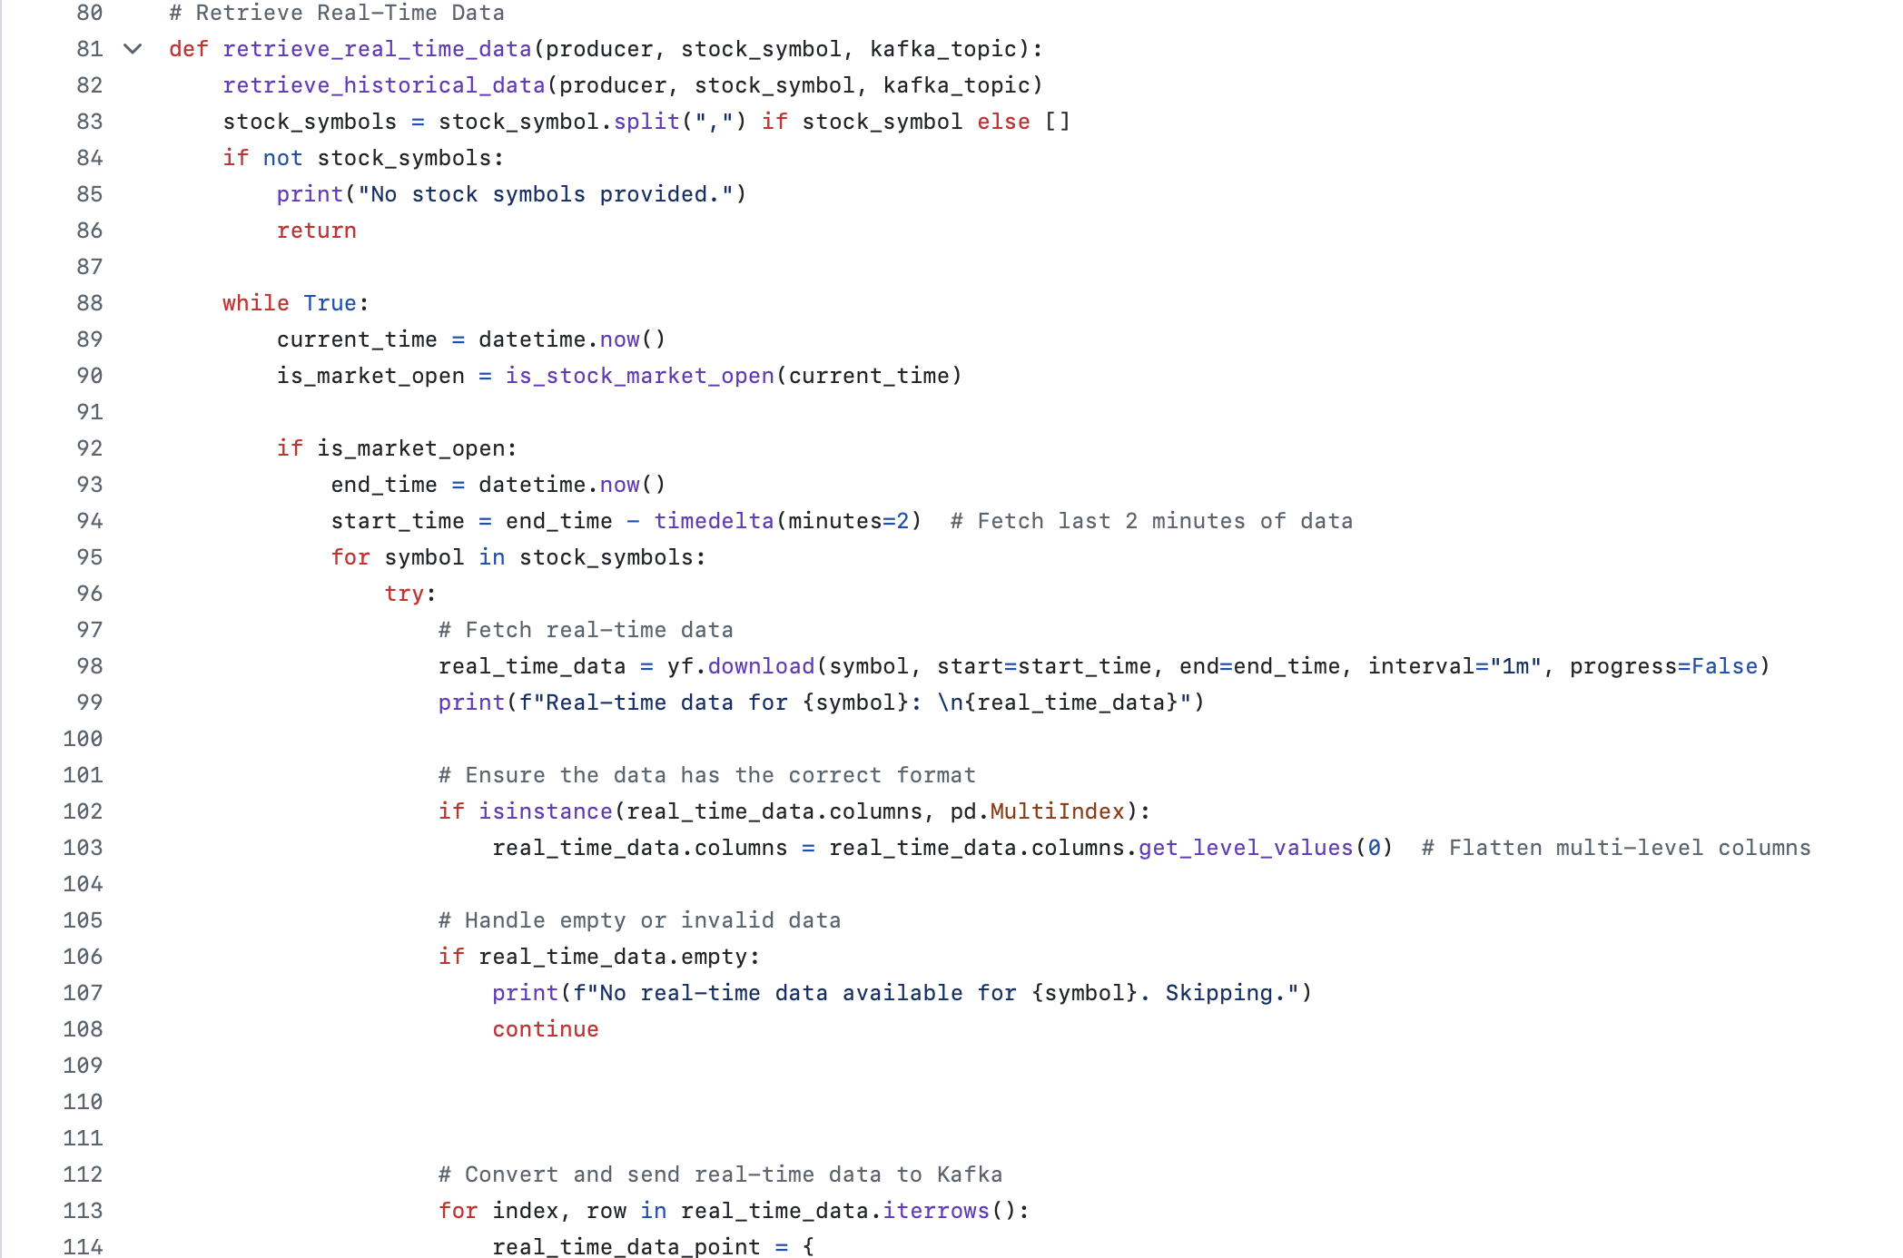
PRODUCER.PY RETRIEVING REAL TIME DATA:

Slide 17
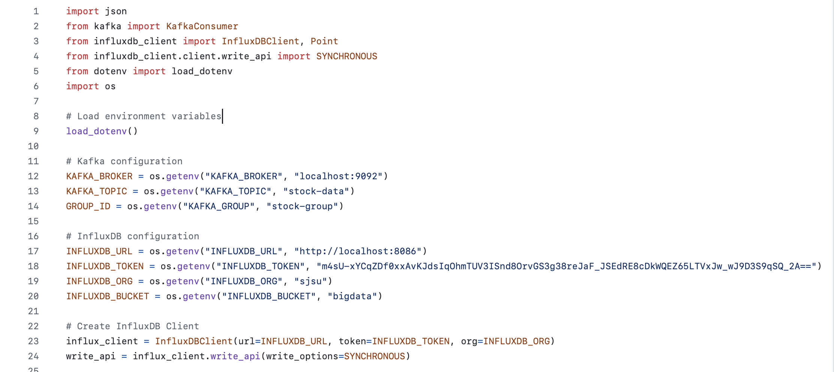
CONSUMER.PY CONFIGURATIONS

Slide 18
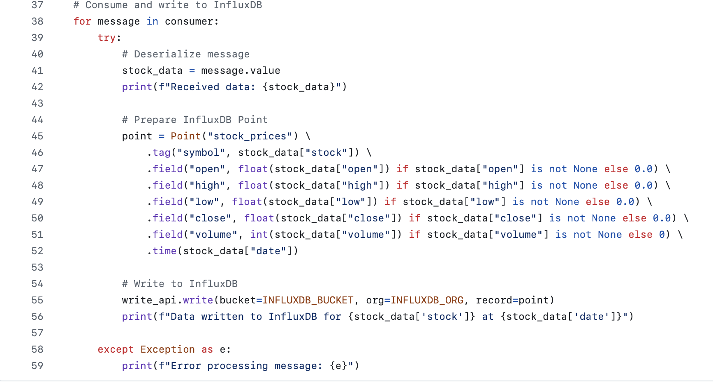
CONSUMER.PY – PUSHING DATA TO INFLUXDB

Slide 19
DATA STORAGE IN INFLUXDB​
Schema Design:​
Measurement: Represents stock prices, where each record captures the data of a stock symbol like AAPL or GOOGL.
Tags:
Symbol: Represents the stock identifier (e.g., AAPL, GOOGL).
Company Identifier: Distinguishes between multiple stocks in queries.
Fields:
Open: Stock's opening price (default 0.0 if None).
High: Stock's highest price in the interval (default 0.0 if None).
Low: Stock's lowest price in the interval (default 0.0 if None).
Close: Stock's closing price in the interval (default 0.0 if None).
Volume: The number of shares traded (default 0 if None).
Predicted Price: Values generated by the LSTM model for future predictions.
Timestamps: Each data point is tied to a precise timestamp, providing time-series data for accurate analysis.
Item 2

Slide 20
DATA VISUALIZATION WITH GRAFANA​
Key Features:​
Real-Time Stock Prices:​
Live updates every minute from Kafka, visualized in interactive Candle Stick chart.​
Predicted Stock Prices:​
Displays LSTM-based predictions alongside actual stock prices.​
Historical Trends:​
Displays last 90-days historical data.​
User Interface:​
Company Dropdown: Select companies (e.g., AAPL, GOOGL) to update the dashboard.​
KPI Cards: Show volume, yesterday’s closing price, and tomorrow's prediction.​
​
Item 2

Slide 21
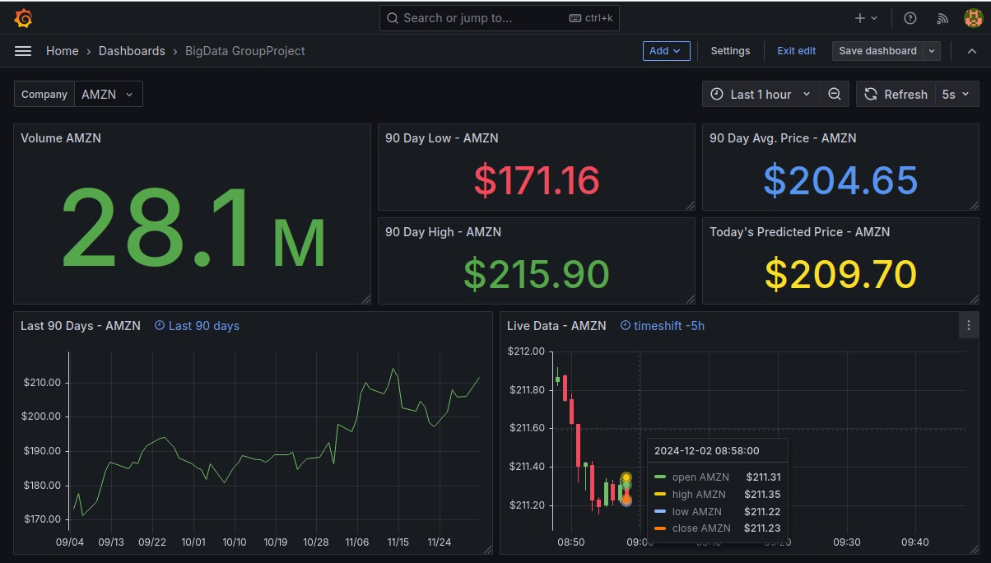
GRAFANA DASHBOARD

Slide 22
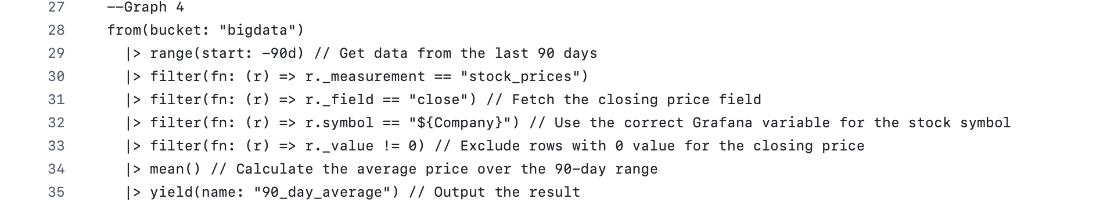
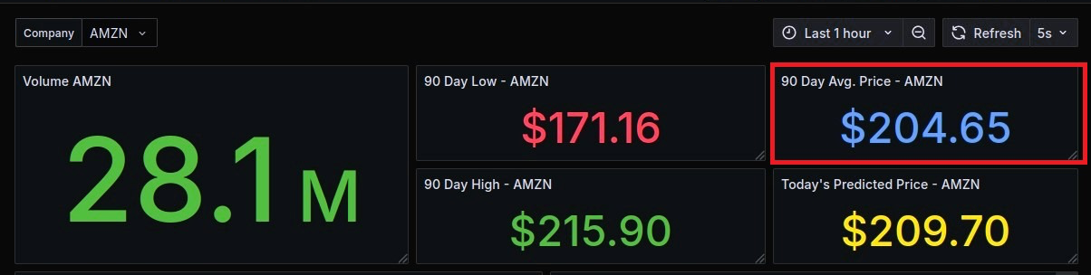
Grafana Dashboard Visuals
Code
Visual

Slide 23
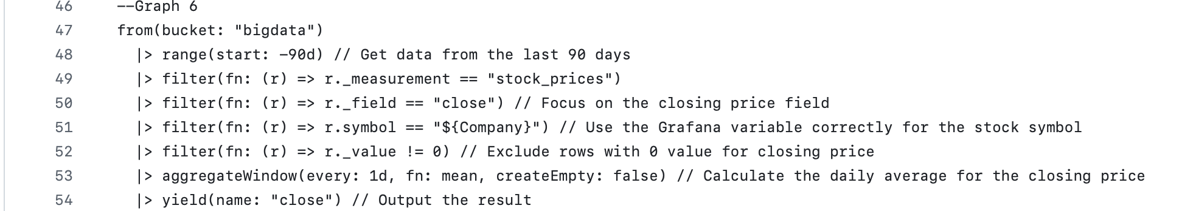
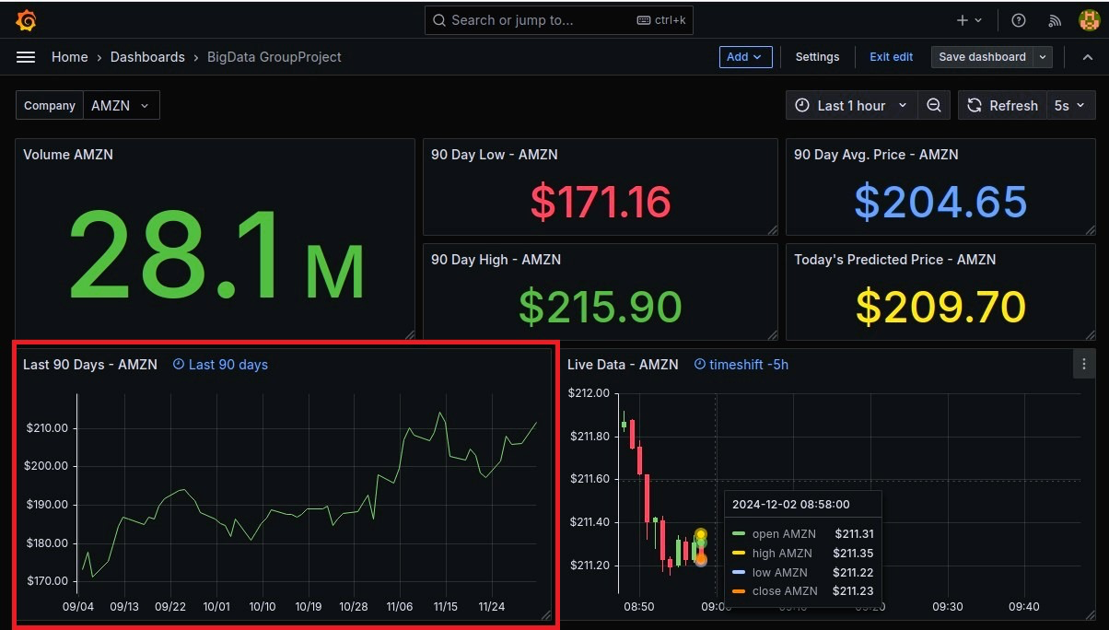
Grafana Dashboard Visuals
Code
Visual

Slide 24
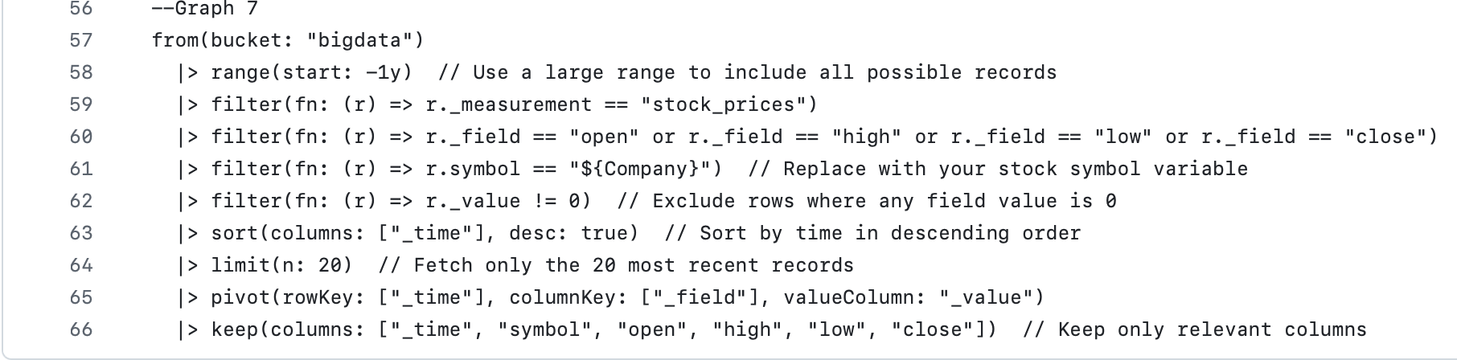
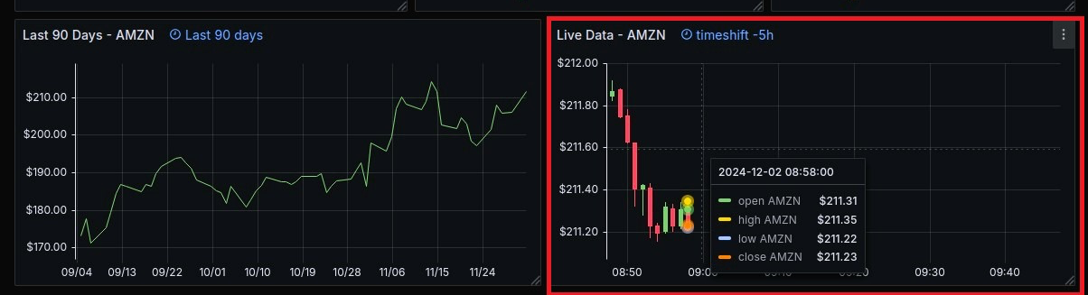
Grafana Dashboard Visuals
Code
Visual

Slide 25
RESULTS
Item 2
LSTM Model Accuracy: Achieved reliable stock price predictions
Real-Time Processing:
Apache Kafka: Enabled efficient, low-latency streaming of live stock data.
InfluxDB: Seamlessly stored time-series data for querying historical and live trends.
Visualization Excellence:
Grafana Dashboards: Displayed real-time and predicted stock prices, technical indicators, and KPIs with user-friendly interactivity.

Slide 26
CONCLUSION
Item 2
This project successfully integrates:
LSTM for stock price prediction
Apache Kafka for real-time data streaming
InfluxDB for time-series data storage
Grafana for visualization
The platform provides a scalable solution for stock price analysis and predictions, paving the way for advanced systems in financial analytics.

